Slide 1
Proximity Sensors: Inductive

Slide 2
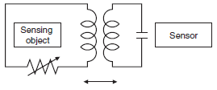
Inductive Proximity Sensors

Slide 3
Inductive Proximity Sensors
A high-frequency magnetic field is generated by coil.
When a target approaches the magnetic field, an induction current (eddy current) flows in the target due to electromagnetic induction.
As the target approaches the sensor, the induction current flow increases, which causes the load on the oscillation circuit to increase.
Then, oscillation attenuates or stops.
The sensor detects this change in the oscillation status with the amplitude detecting circuit, and outputs a detection signal.

Slide 4
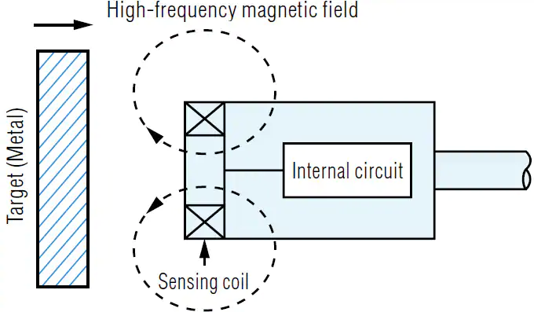
Inductive Proximity Sensors

Slide 5
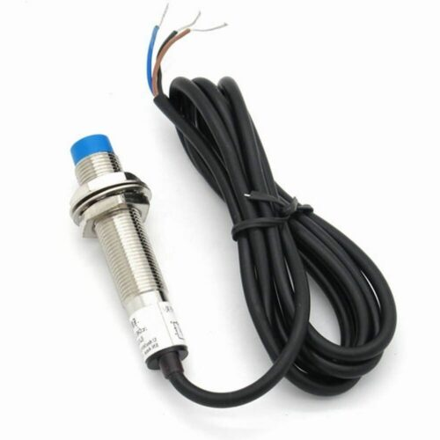

Slide 6
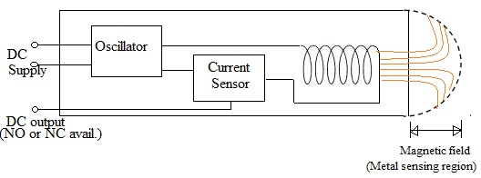
Inductive Proximity Sensors

Slide 7
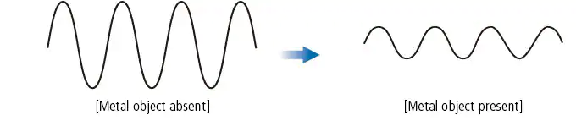
Inductive Proximity Sensors(ferromagnetic Substance)

Slide 8
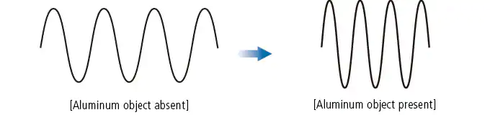
Inductive Proximity Sensors(non-ferromagnetic Substance)

Slide 9
Inductive Proximity Sensors(Advantages)
They are usually used within harsh environments as they are generally robust and can deliver stable signals even in hostile environments.
Contactless Detection
Very accurate compared to other technologies.
They have a high switching rate.
It has longer life.
It is very easy to install.
It has very predictable results and performance.
Capable and versatile in metal sensing.
Considerably cheap when it comes to price

Slide 10

Inductive Proximity Sensors(Applications)
Forklift trucks.
Anti Aircraft Missiles
Monitoring component position within hydraulic machines
Industries that mold plastic parts.
Machine vibration monitoring to measure the variation in distance between a shaft and its support bearing
Parking sensors, systems mounted on car bumpers that sense distance to nearby cars for parking.

